Slide 1
engineering

Slide 2
Why I wanted to do research this
The reason why I wanted to research this was because a engineer is very talented and can do a lot of things depending what engineer they are. Engineer could create almost anything if they just had the right tools. And all the items that the other people in this classroom are researching and want to make could actually be made by a engineer.

Slide 3
Engineering in general
Though there are many different engineers a engineers in general develop things we as earth use
most engineers need a bachleors degree or higher to be a engineer

Slide 4
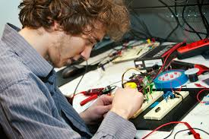
computer engineer (er) (ing)
One of those engineers are Computer Engineers. Computer engineers refers to the study that integrates electronic engineering with computer sciences to design and develop computer systems and other technological devices. There pay is $111,730 a year.

Slide 5
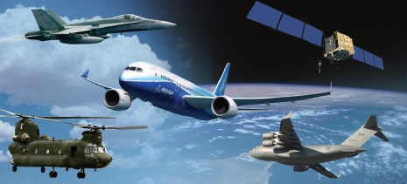
Aerospace engineers
Aerospace Engineers design aircraft and spacecraft like helicopters or spaceships. They also design bombs and satellites. They must have a bachelors degree to be a Aerospace Engineer.

Slide 6
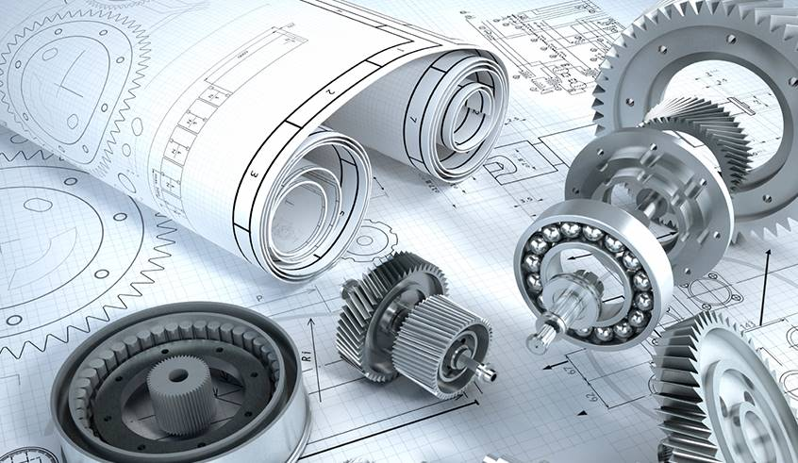
Mechanical engineers
Mechanical Engineers are one of the most common engineers. Mechanical Engineers design, develop, build, and test mechanical systems. You need a bachelors degree to be a Mechanical Engineer.

Slide 7
Electrical engineering
Electrical Engineers work on all the different things that have do with electrical stuff also they build radars. Must have a lot of knowledge to be an electrical engineer.

Slide 8
Civil engineering
Civil Engineers build and design buildings, roads, airports, sewers, and bridges publicly privately. Civil Engineers make$63457 a year.

Slide 9
Chemical engineer
Chemical Engineers use chemicals, biology, math, and physics to solve problems that involve the production or use of chemicals, fuel, drugs, food, and many other products. They make $98,340 per year. You need a bachelors degree to be a Chemical Engineer.

Slide 10
What I plan to do with my research
I plan to be one of those engineers and become one of the most famous and best engineers in the world. Also I will make one of the best inventions

Slide 11
The end
That is all the engineers

