Slide 1
Rome.
By Keaton Schroer.

Slide 2
I picked this because it is really interesting and I want to know more about the Romans.

Slide 3
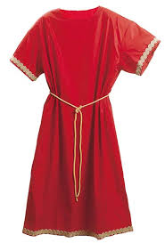
I started by going to a Roman website and looked up what they had worn back then. They wore all kinds of things. They wore tunics and sandals with thick gold wrist bracelets.

Slide 4
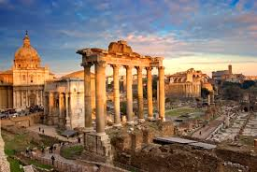
I had to really look up what special places there are. The first one is the Rome Colosseum. Next is the Pantheon and the Roman Forum and the Trevi Fountain.

Slide 5
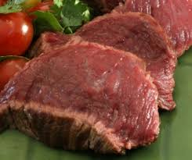
I had to look up what they eat. They eat fish and cold meat. And eat bread for breakfast with pancakes. They still have three meals and cook there things on a fire.

Slide 6
I knew but went to a Roman any way to look up what they’re culture is. They started the Olympics. They praise to the gods for good luck. Every year they did that until another country wanted to do it.

Slide 7
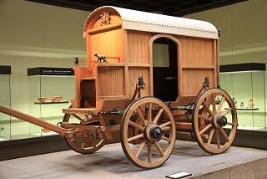
I went on a Roman website to find out what they used for transpiration. They used horses and they walked. With the horses they had buggy's and carriages.

Slide 8
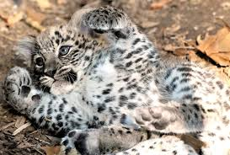
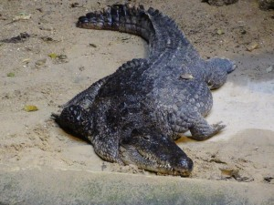
Finally I went to the Roman website again and looked up animals that were there. There are wild boars and lions. There are crocodiles and lynx and horses.

Slide 9
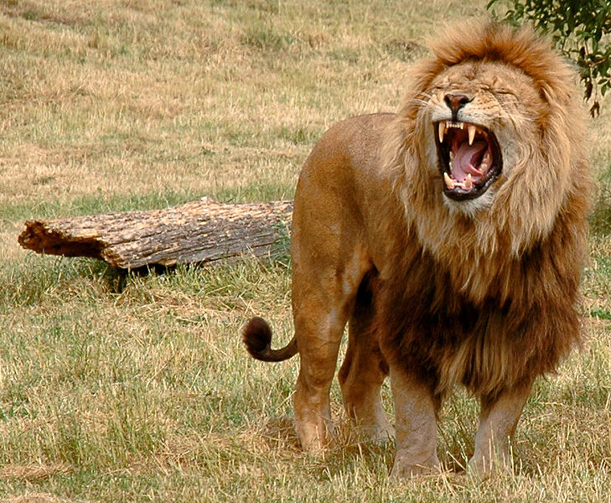
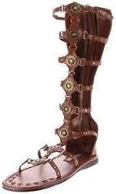
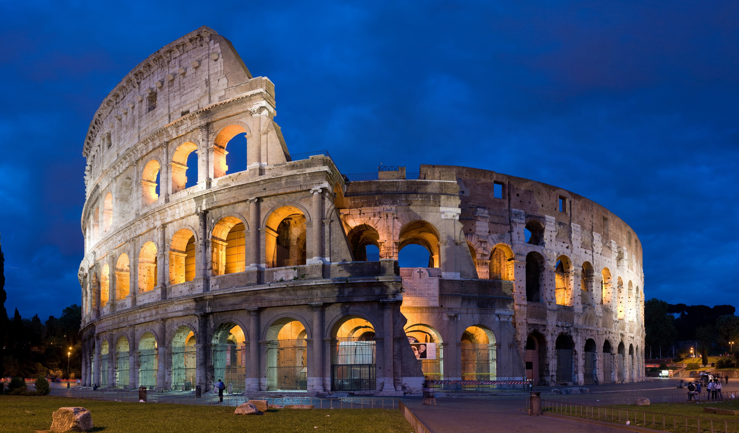
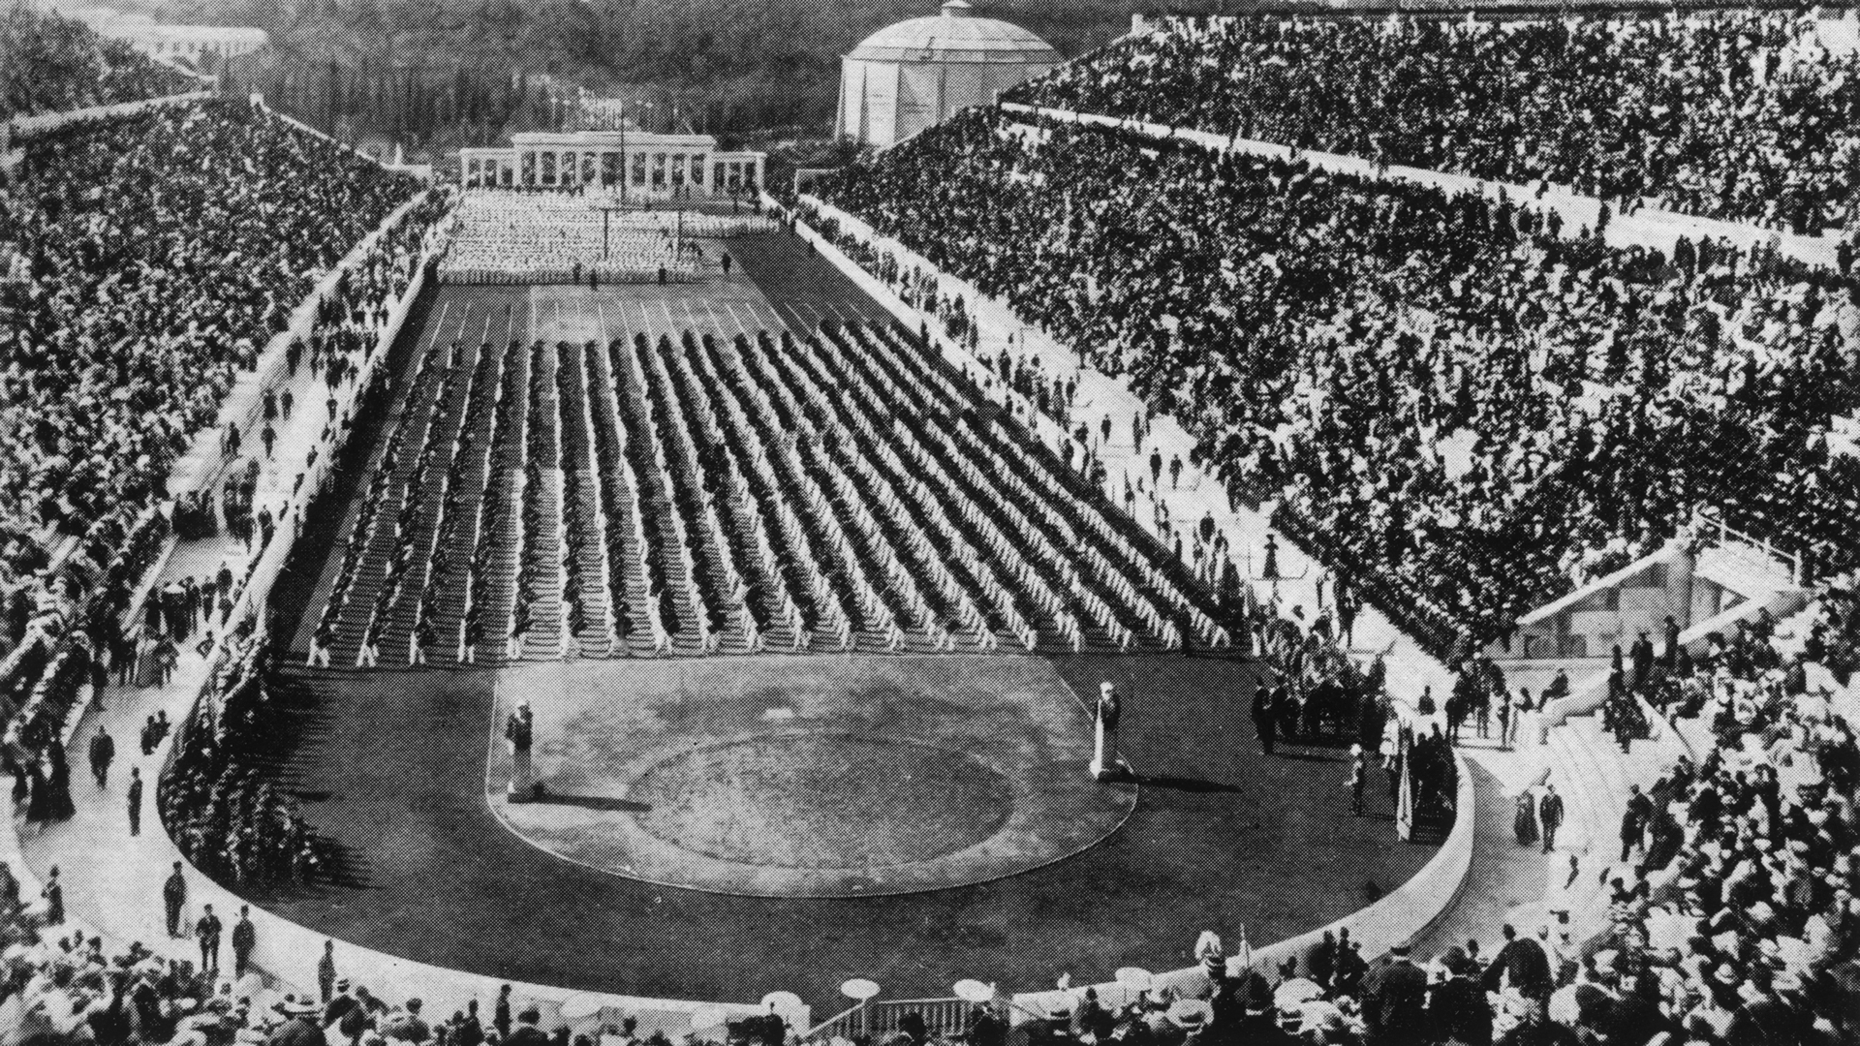
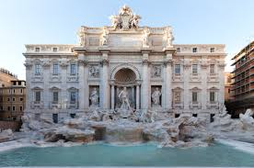
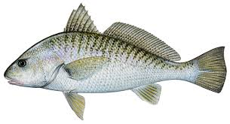
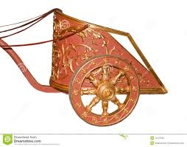
After I do this I am going to keep researching. Then I will ask my mom if we could have a vacation there. Hopefully I might be able to go there…

Slide 10
I used a Roman website called Roman facts. I read the whole entire website! It took time but it was worth it and I learned a lot. This website is really good if you ever need facts are pictures go to that website.
Do you like these pictures from Roman facts.

Slide 11
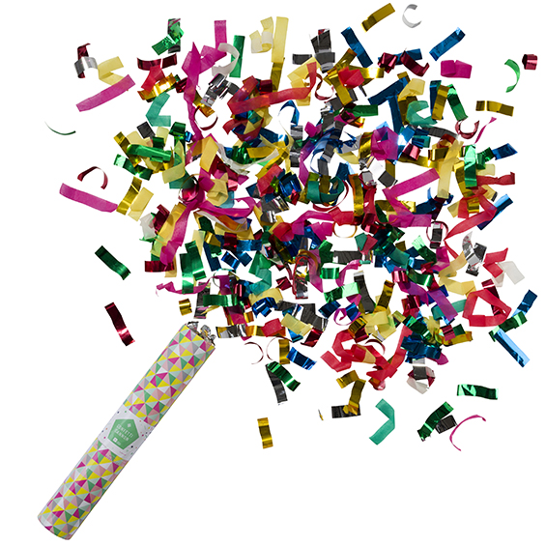
The end!!!!!!

