Slide 1
Double boat
by: Molly

Slide 2
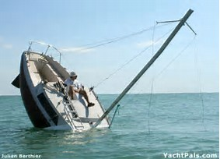
My Idea
My idea is a boat inside of a boat- a Double Boat . If you are in a boat and you get hit and no one is near what will you do? Well, if you are in a double boat you can cut the rope connecting the small boat with passengers from the bigger boat. The big boat will sink and the small boat will stay on the water safe.

Slide 3
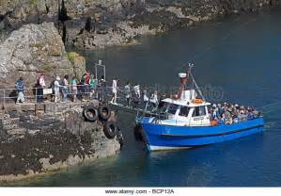
WHY I WANT TO DO THIS
I want to do this to reduce the chance of boat accidents. I want to have a safer way of transportation. I don’t want people going on a boat ride worrying if they might hit something and the boat will sink.

Slide 4
How I Plan To Do This
I plan to do this by building a wooden boat for the outer boat. For the inner boat I will do the same thing as the bigger boat except smaller. Then, I will connect the two boats with thick rope.

Slide 5
Rope
The rope connecting the two boats will be very thick. To cut the rope the captain, or whoever else cuts it, will have to use big, strong scissors. The rope connects the two boats and will hold up the smaller boat until the bigger boat gets hit.

Slide 6
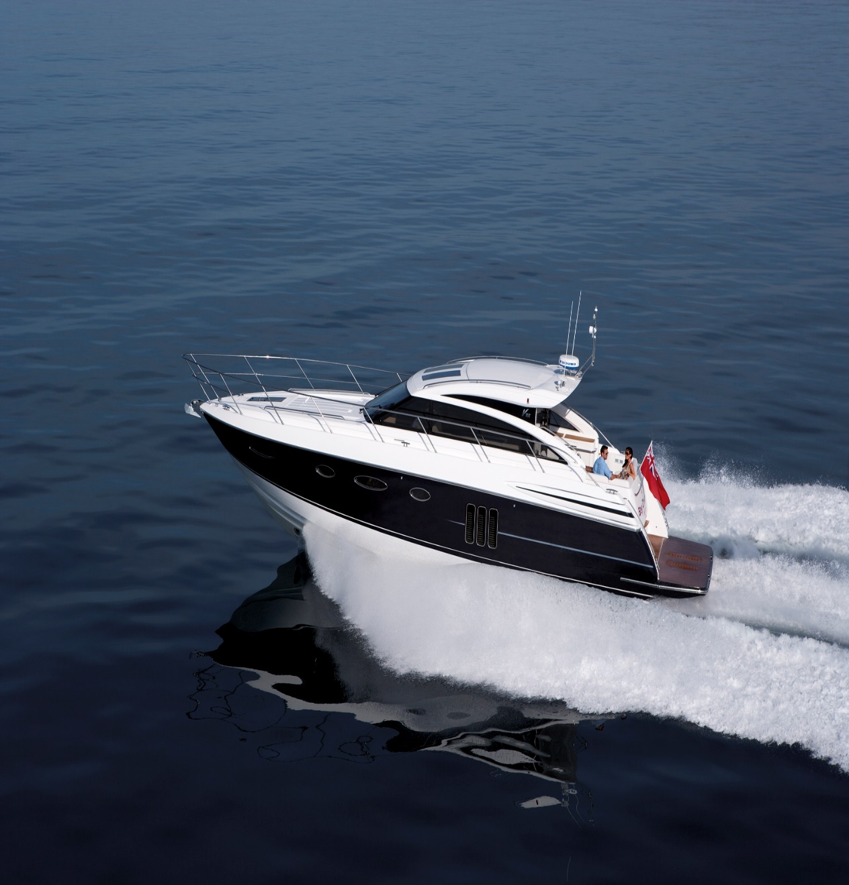
Motors
Both boats will have a motor connected to it. If the big boat crashes and are in the smaller boat, you should avoid any other obstacles. If you happen to hit the smaller boat you will most likely be close to shore. If you are not close to shore and your boat is about to sink, hope that you brought rafts or life boats!

Slide 7
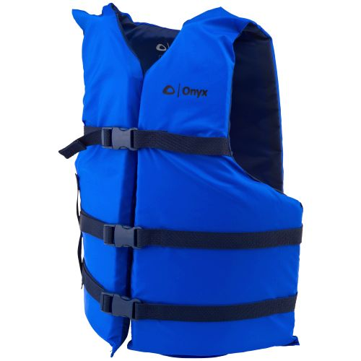
Safety TIPS life vests
You should were a life vest. Just in case something goes wrong you need to wear a life vest. Make sure every person on board has a life vest. It is important to wear one because if the boat sinks you can stay above water.

Slide 8
Safety tips Bad weather
During bad weather you should be very carful. You should get under any seats or big objects during the event of harsh weather. Cover your head with your arms or with an object. If it is just a thunder storm you should get something to cover you from the rain and avoid any medal objects.

Slide 9
http://www.bing.com/images/search?q=thick%20rope%20&qs=n&form=QBIR&sp=-1&pq=thick%20rope%20&sc=8-11&sk=&cvid=13F44E8A47F142C095F73EC8547F5510http://www.bing.com/images/search?q=boats%20sinking&qs=n&form=QBIR&sp=-1&pq=boats%20sinking&sc=7-13&sk=&cvid=031FEF488D514B2D9E7D91152BAC0C59http://www.bing.com/images/sehttp://www.bing.com/images/search?view=detailV2&ccid=uPZL50G2&id=1A80565CEE3409F042DD073AEE536C4F52B0BC73&thid=OIP.uPZL50G2PIivdFbbe2zF9AEsDh&q=+making+wooden+boats&simid=607992629829698711&selectedIndex=48&ajaxhist=0arch?vhttp://www.bing.com/images/search?q=people%20boarding%20boats&qs=n&form=QBIR&sp=-1&pq=people%20boarding%20boats&sc=0-21&sk=&cvid=C8559939877042909A297EA08F1FF8A3iew=detailV2&ccid=I8w6dC5r&id=EA728DDDBEBBBBB13FBD71F64A5CF4C9D522C6B0&thid=OIP.I8w6dC5rEwQyiCo7OTwpuwEsCZ&q=moter+boats&simid=607987085051430010&selectedindex=1&mode=overlay&first=1http://www.academy.com/shop/browse/boating/life-vests--jackets/fishing-boating-vests
Websites
http://www.bing.com/images/search?q=people+boarding+boats&FORM=HDRSC2

Slide 10
Thank you for watching the end

